Slide 1
Test-Time RL for Verifiable Optimization Problems
AlphaGrad

Slide 2
What we are optimizing
LLMs are good at generating solutions, but bad at verifying them
  Many approaches have tried to answer this (ex. LLM as a Judge)
One solution: evaluate LLMs against a strictly verifiable problem
Many such examples:
Kernel speed
Matrix multiplication algorithm speed
Erdos problems

Slide 3
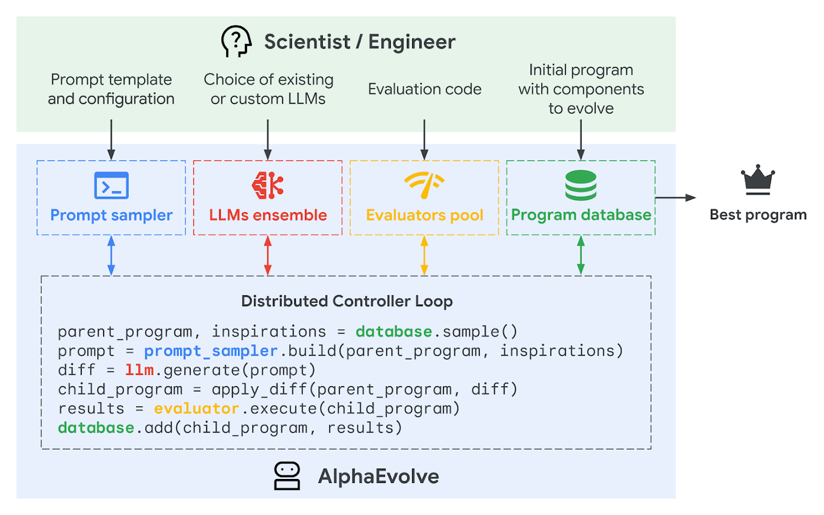
Background: AlphaEvolve
Google’s new system for autonomous discovery
Proposes “edits” to existing solutions, refines them over many rounds
Produces state of the art solutions for problems:
  Cut down speed by 0.7% of data centers using new scheduling algorithm
  Advanced a 300-year-old geometric puzzle discovering 593 spheres in 11 dimensions (prev. 592)
  faster method for multiplying complex matrices, achieving this in just 48 scalar multiplications.

Slide 4

Circle packing

Slide 5
Idea: Add in reinforcement learning during test time
Generate: LLM proposes a candidate packing
Verify: deterministic checks (inside square + no overlap)
Score: valid → sum of radii, invalid → 0
Learn: update LoRA to increase probability of high-reward proposals
Repeat: buffer stores best solutions to guide future sampling (search + learning)

Slide 6
TTT-Discover
LLM doesn’t output circle coordinates directly
It writes Python code that computes a packing
Executes code locally and is verified
LLM is proposing algorithms, not just solutions — more powerful than searching coordinate space directly
Benefits:
  more structure + reuse (symmetry, templates, heuristics)
  easier to enforce constraints programmatically
  searches a richer space than direct coordinate sampling

Slide 7
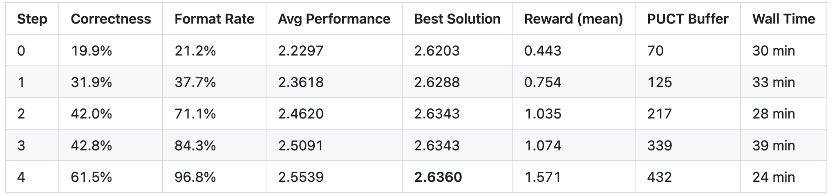
Initial results
5-epoch training runs
SOTA benchmark target matched at step 4
Correctness rate tripled over training
Format compliance improved 4.6x
Average performance improved by 14.5%

Slide 8
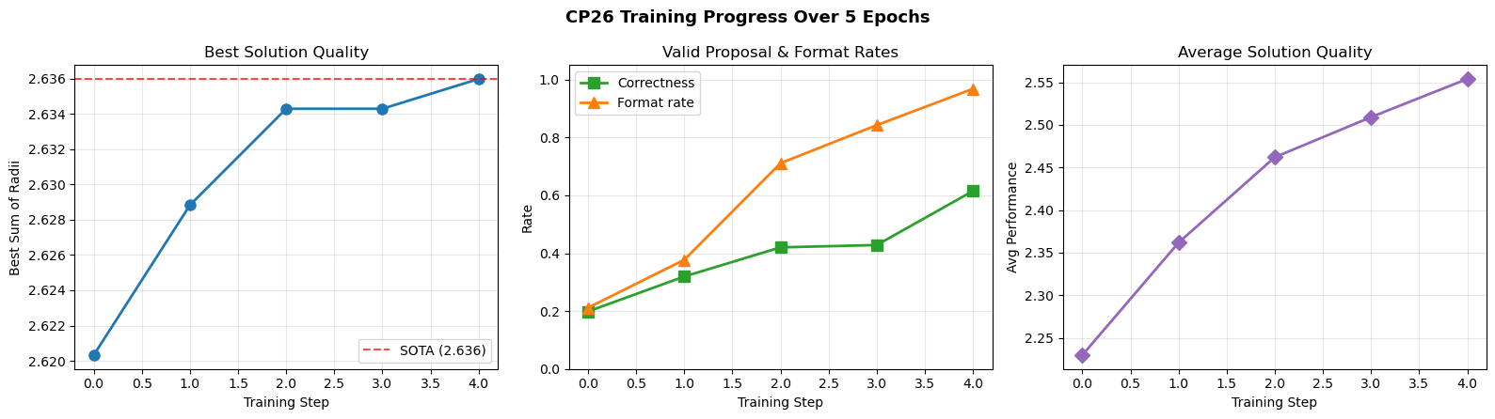
Initial results

Slide 9
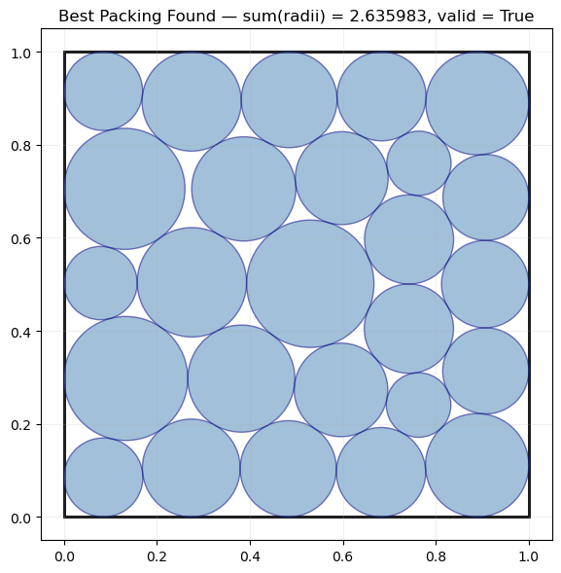
Optimal solution we found (matches SOTA)

Slide 10
Steps forward:
Compare to Baseline Model
Choose a problem to further optimize (CP26)
  Token efficiency: constrain generation format to reduce wasted tokens
  Reward shaping: partial credit for near valid configs (overlap magnitude, violations)

